Slide 1
Forecasting Flight Delays
Arjun Venkatesh, Ryan Nathenson, Adrian Barba, Ethan Fischbein

Slide 2
Objective
Thousands of flights and delayed each month from O’Hare airport.
Delays costs airlines thousands of dollars each year, and also creates planning issues for airlines.
Delayed flight costs are difficult to plan for
Need to allocate resources to account for delays
Also affects airports ability to service customers
If we are able to model upcoming delays can assist in these planning issues, and maybe even help reduce delays.

Slide 3
Data Profile
Initial data taken from Bureau of Transportation
Initially aggregated by airport and service provider monthly
We focus on O’Hare airport, and aggregate providers to get monthly time series
Result is dataset of flights from June 2003 to May 2022
Focus on flight and delay data
Column | Description
Flights | Total flight departures
Delays | Total delays (>15 min)
Carrier | Delays caused by carrier
Weather | Delays caused by weather
NAS | Delays caused by national service
Security | Delays caused by security
Late Aircraft | Delays caused by late aircraft
Cancellation | Total flight cancellations
Diversions | Total flight diversions

Slide 4
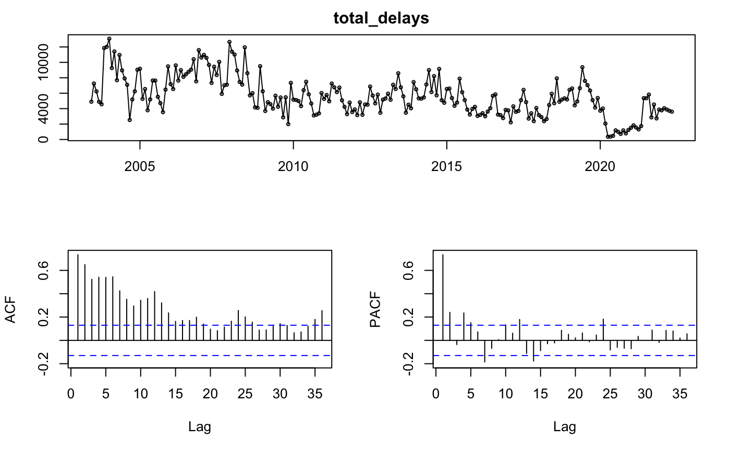
Data Overview - Delays
Non stationary model - seasonality (multiplicative)
By ACF and PACF the time series looks like an AR model
Several “interventions” that make the data particularly spikey
Data is not normally distributed so Box-Cox transformation was applied
KPSS test indicates that the model that first order differencing results in stationary trend

Slide 5
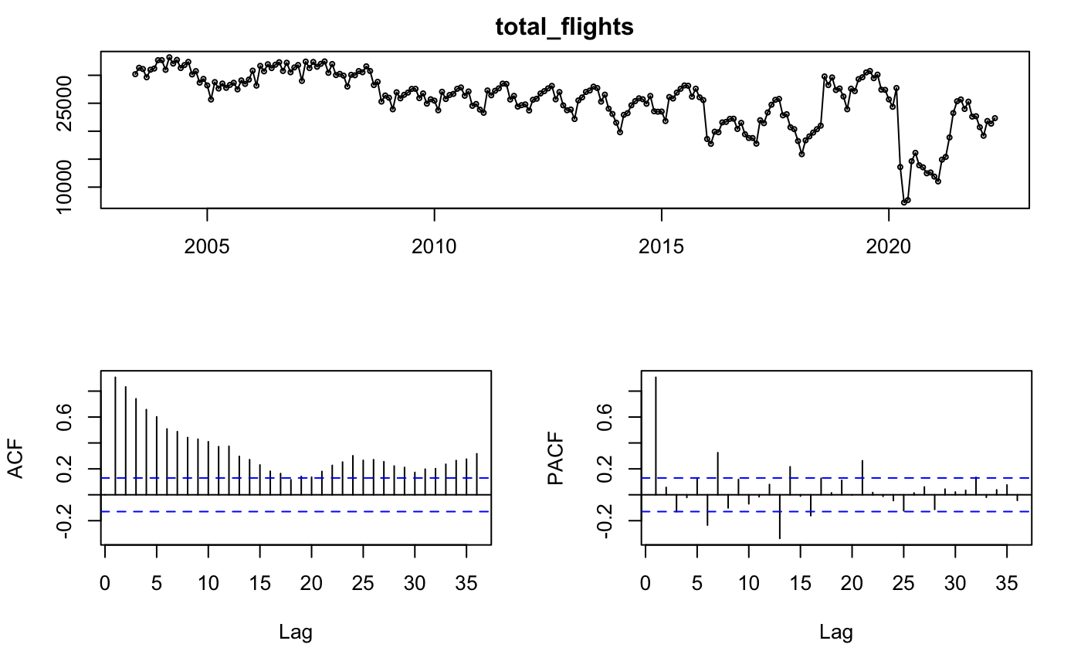

Data Overview - Flights
Similar traits to delays, but with less variance

Slide 6
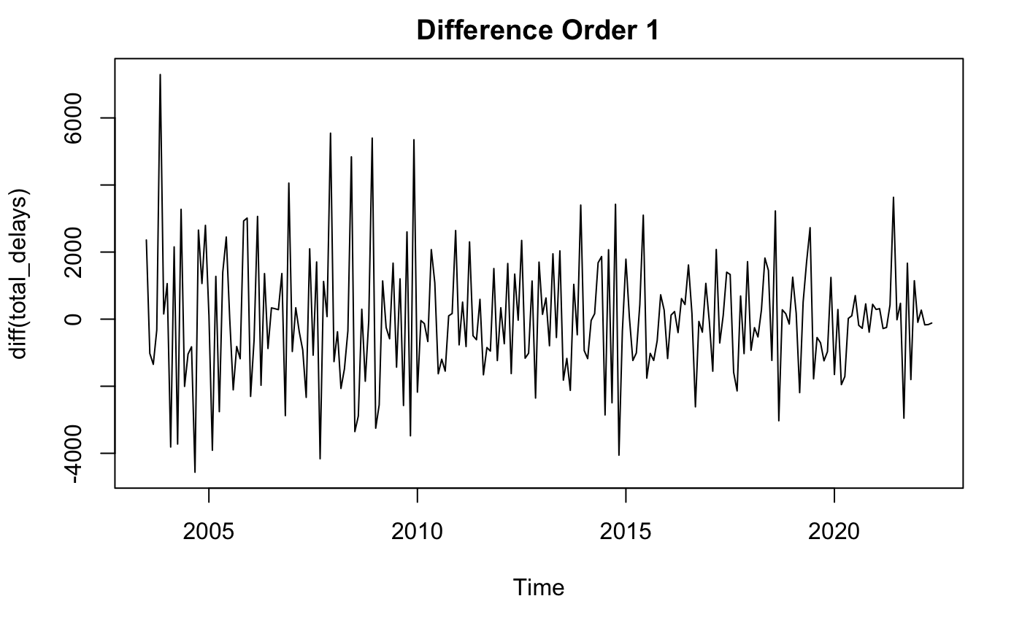
Data Overview - Hypothesis Testing
Need to ensure stationary data - KPSS test indicates p value 0.1.
Differenced data looks similar to white noise

Slide 7

Model Selection Criteria
Want to choose a model that predicts delays as accurately as possible
Will try both simple and complex models in order to find best model
Use cross validation to evaluate
Use Traditional measures to evaluate (RMSE, MAPE etc.)
Presence of shocks makes train/test methodology more difficult
Need to account for COVID causing drop in flights in the last two years
Can exclude that data when conducting train test
Or try to account for this using intervention or xreg analysis
For train/test models will use window before Covid (cut off at Dec 2019)
Train : Jun 2003 - Dec 2018
Test : Jan 2019 - Dec 2019

Slide 8
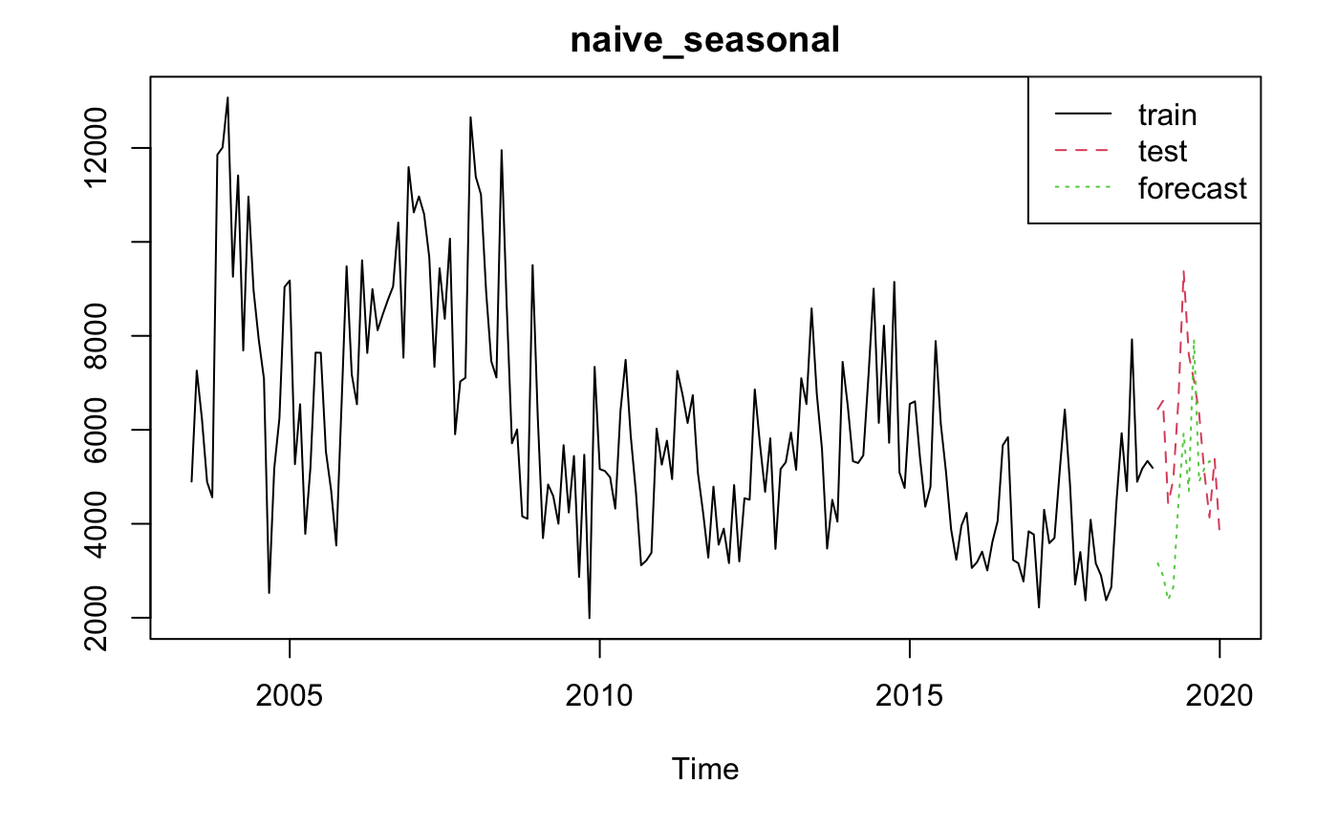
Seasonal Naive
ME RMSE MAE MPE MAPE MASE ACF1 Theil's U
Training set -282.36 2352.221 1792.360 -12.88945 34.54266 1.000000 0.5275181 NA
Test set 1612.75 2298.924 1970.917 24.24764 31.39647 1.099621 0.4578914 1.475725

Slide 9
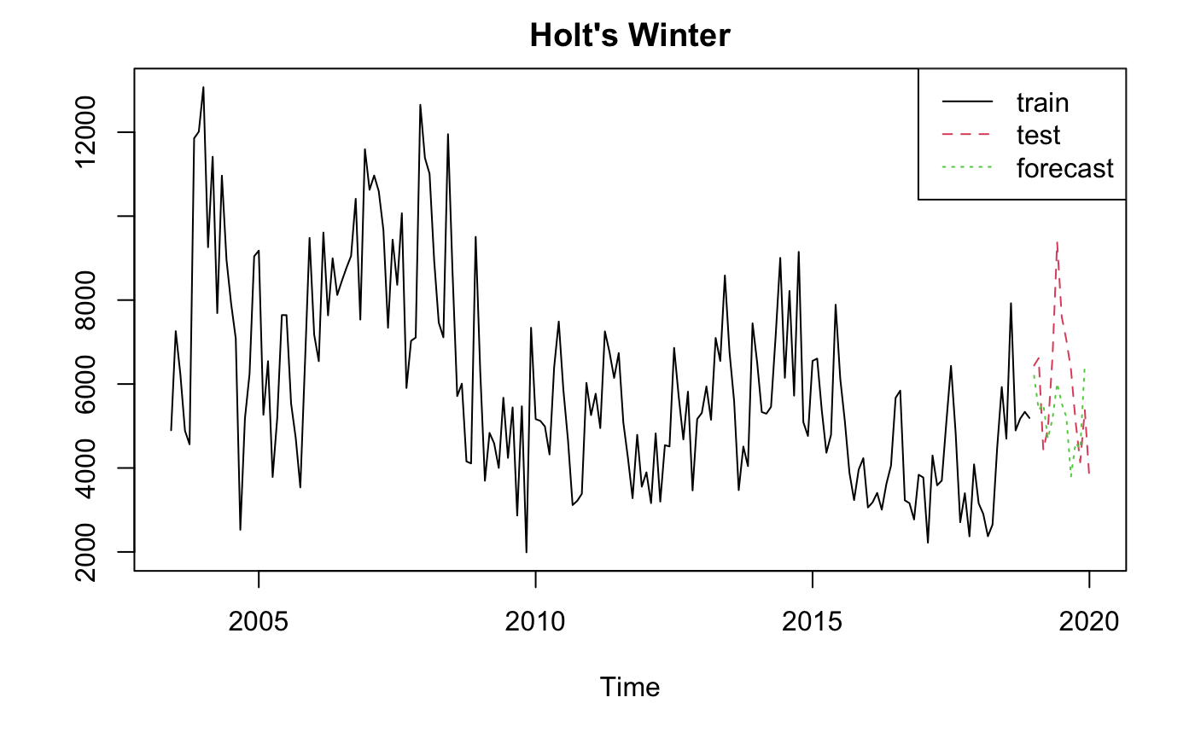
Holt’s Winter Method
ME RMSE MAE MPE MAPE MASE ACF1 Theil's U
Training set -13.10431 1514.152 1161.923 -5.731315 21.22816 0.6482641 0.09829551 NA
Test set 915.60166 1631.127 1333.643 11.303012 20.10270 0.7440709 0.41875045 1.07699

Slide 10
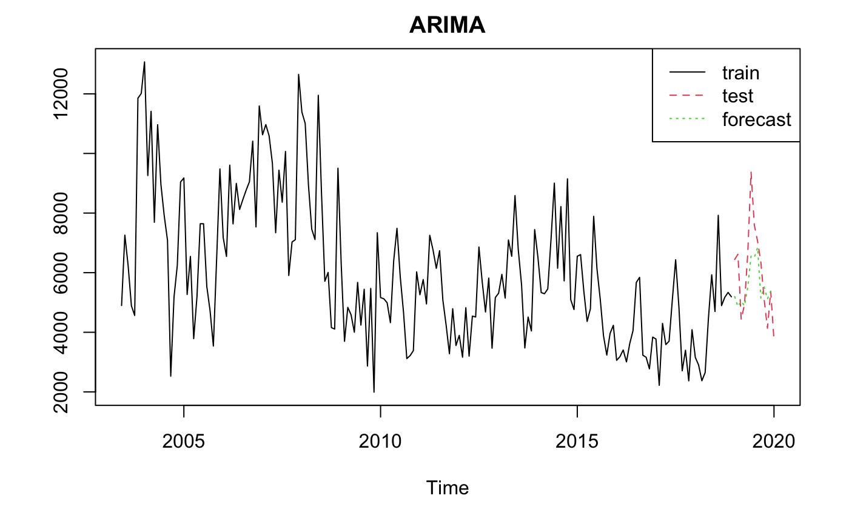
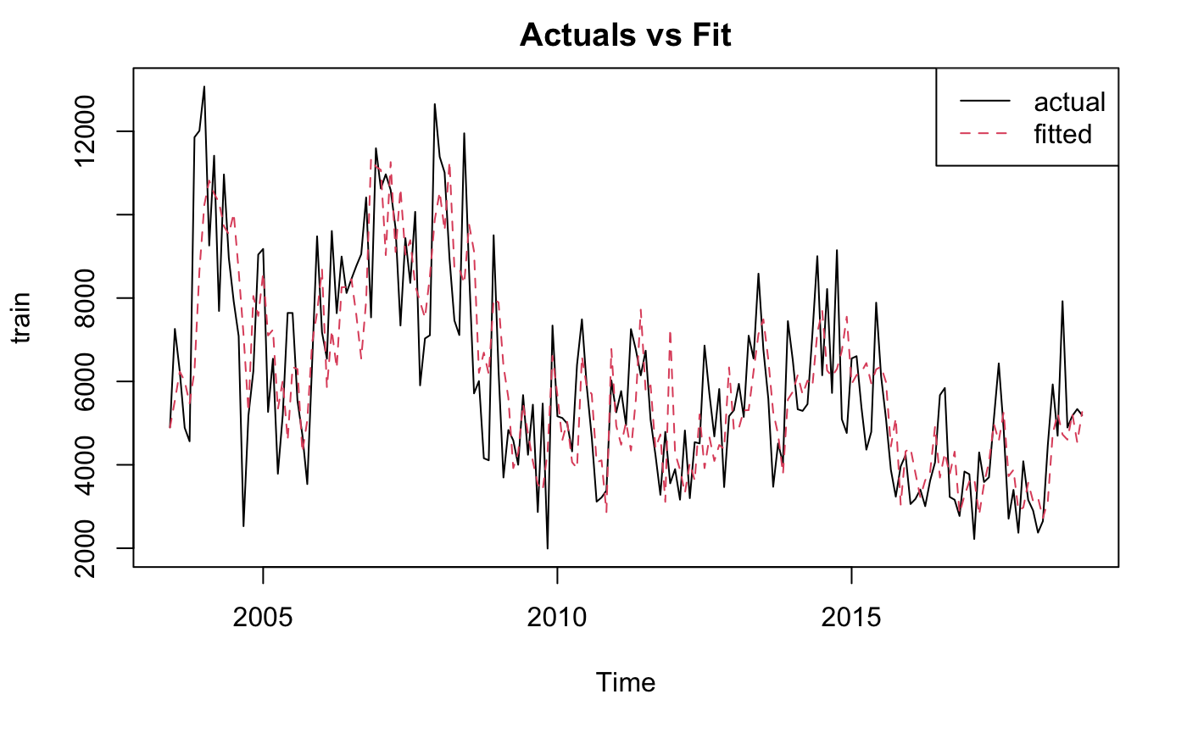
ARIMA Model
Using auto.arima() specified order of (0,1,1)(2,0,2)[12] with AICc of 276.09:
Fit | ME | RMSE | MAE | MPE | MAPE | MASE | ACF1 | Theil.s.U
Train Data | 117.266 | 1569.329 | 1193.581 | -3.520412 | 20.99045 | 0.6659269 | 0.01478414 | NA
Test Data | 707.865 | 1196.366 | 911.4009 | 8.976552 | 13.65075 | 0.5084921 | 0.11624144 | 0.7692903

Slide 11
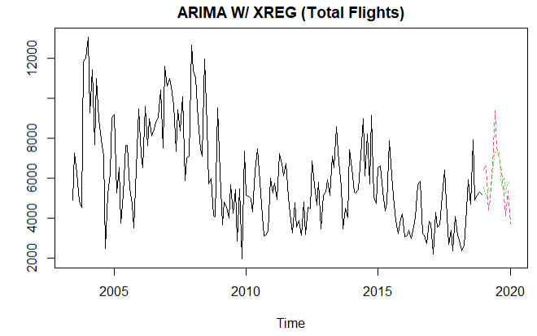
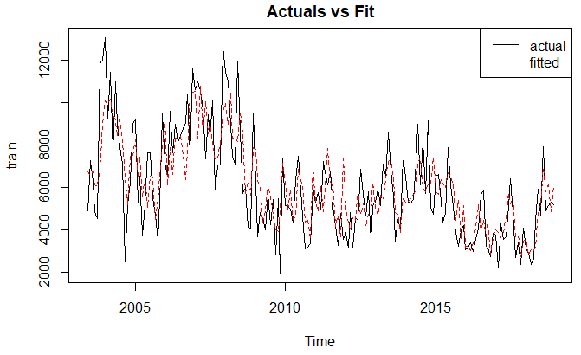
Regression w/ Arima Errors (Total Flights)
Using auto.arima() w/ XReg specified order of (1,0,0)(0,0,1)[12] with AICc=267.4. Using flights as the XReg improved the model from the standard auto.arima(), based on AICc and below metrics:
Fit | ME | RMSE | MAE | MPE | MAPE | MASE | ACF1 | Theil.s.U
Train Data | 188.9876 | 1554.638 | 1195.531 | -3.743369 | 21.26826 | 0.6670149 | 0.009982444 | NA
Test Data | -275.0593 | 1234.267 | 1055.893 | -8.875343 | 19.54471 | 0.5891078 | 0.227322158 | 0.8428711

Slide 12
Comparing Models Pre-Covid
Train Data
Model | ME | RMSE | MAE | MPE | MAPE | MASE | ACF1 | Theil.s.U
Seasonal Naive | -282.360000 | 2352.221 | 1792.360 | -12.889454 | 34.54266 | 1.0000000 | 0.527518104 | NA
Holt Winters | -13.104308 | 1514.152 | 1161.923 | -5.731315 | 21.22816 | 0.6482641 | 0.098295505 | NA
Arima | 117.266 | 1569.329 | 1193.581 | -3.520412 | 20.99045 | 0.6659269 | 0.01478414 | NA
Regression w/ Arima Errors | 188.9876 | 1554.638 | 1195.531 | -3.743369 | 21.26826 | 0.6670149 | 0.009982444 | NA
Test Data
Model | ME | RMSE | MAE | MPE | MAPE | MASE | ACF1 | Theil.s.U
Seasonal Naive | 1612.7500 | 2298.924 | 1970.9167 | 24.247645 | 31.39647 | 1.0996210 | 0.4578914 | 1.4757252
Holt Winters | 915.6017 | 1631.127 | 1333.6430 | 11.303012 | 20.10270 | 0.7440709 | 0.4187504 | 1.0769902
Arima | 707.865 | 1196.366 | 911.4009 | 8.976552 | 13.65075 | 0.5084921 | 0.11624144 | 0.7692903
Regression w/ Arima Errors | -275.0593 | 1234.267 | 1055.893 | -8.875343 | 19.54471 | 0.5891078 | 0.227322158 | 0.8428711
Notes:
So far the Arima model performs best, though the model is not very accurate
Including Covid data causes even more issues
Can try to improve model by adding more factors to the model (intervention, xreg, etc)

Slide 13

Analyzing Covid-Era Time Frame
Intervention
Several external events caused changes in level
COVID-19, financial crises
In order to take account shocks, use intervention analysis (ARIMAX) to account
Arima W/ XReg
Includes the total flights as the covariate
Allows us to forecast delays based on the total flights during COVID-19, which saw a steep decline

Slide 14
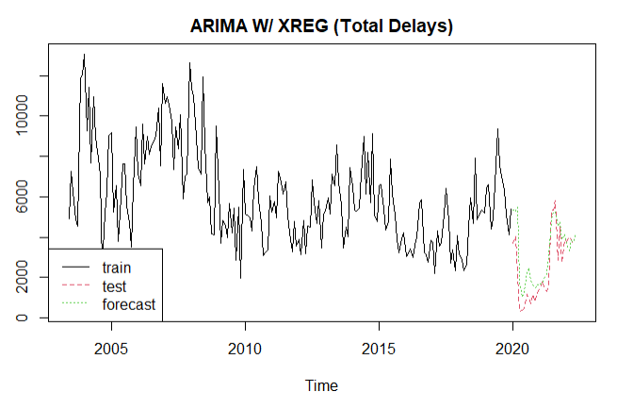
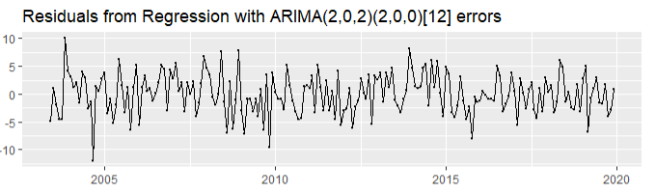
Regression With ARIMA Errors (Covid Era)
The Regression With ARIMA Errors in the covid era resulted in an increase in AICc from the pre-covid era to 1,094.8.
The residuals are normally distributed (based on Shapiro Test), and no autocorrelation remains (Ljung Box Test).
Fit | ME | RMSE | MAE | MPE | MAPE | MASE | ACF1 | Theil.s.U
Train Data | 127.0991 | 1461.256 | 1158.1801 | -4.013456 | 20.71654 | 0.642071 | 0.04249077 | NA
Test Data | -659.6539 | 1072.611 | 808.7703 | -62.814110 | 66.31175 | 0.4483657 | 0.36185040 | 1.46413

Slide 15
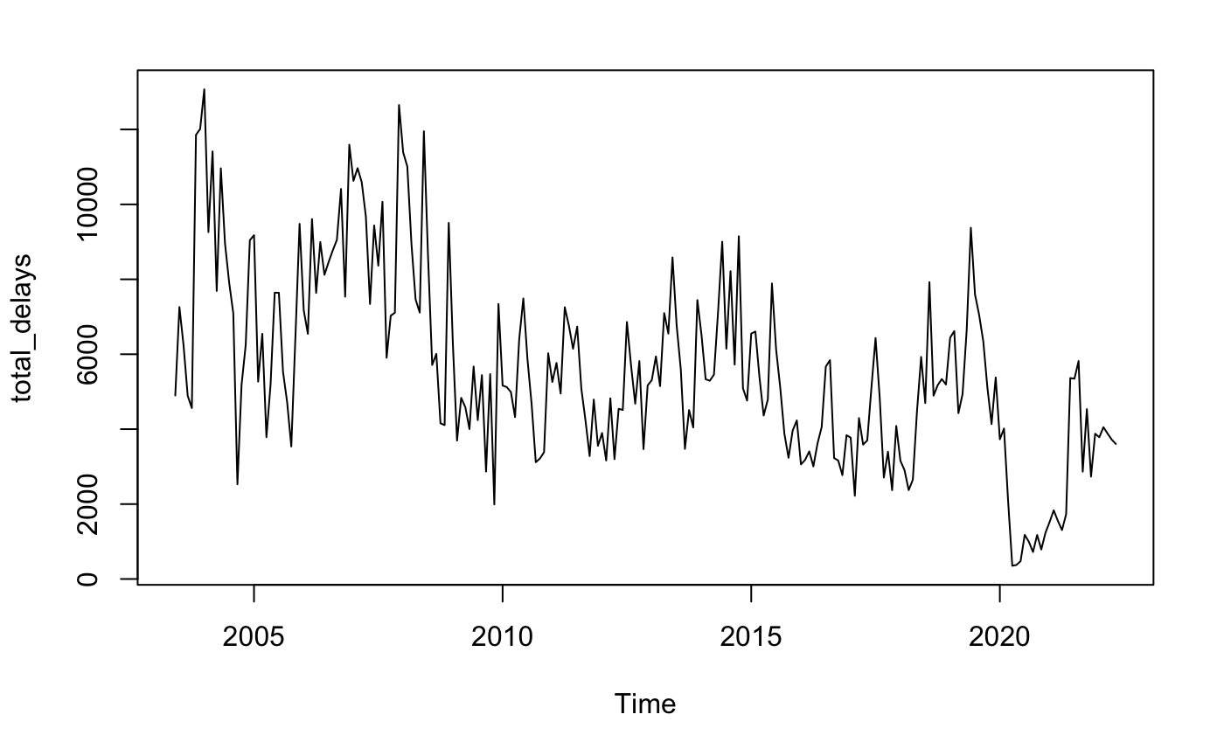
Intervention Analysis
Oct 08 Crisis
Nov 16 Outlier
Nov 04 Outlier
Jan 20 Covid-19
One possible method of improving fit, is to incorporate an intervention analysis
Added interventions accounting for outliers and major events
Pulse interventions for all, except level change for Oct 08 crisis.

Slide 16
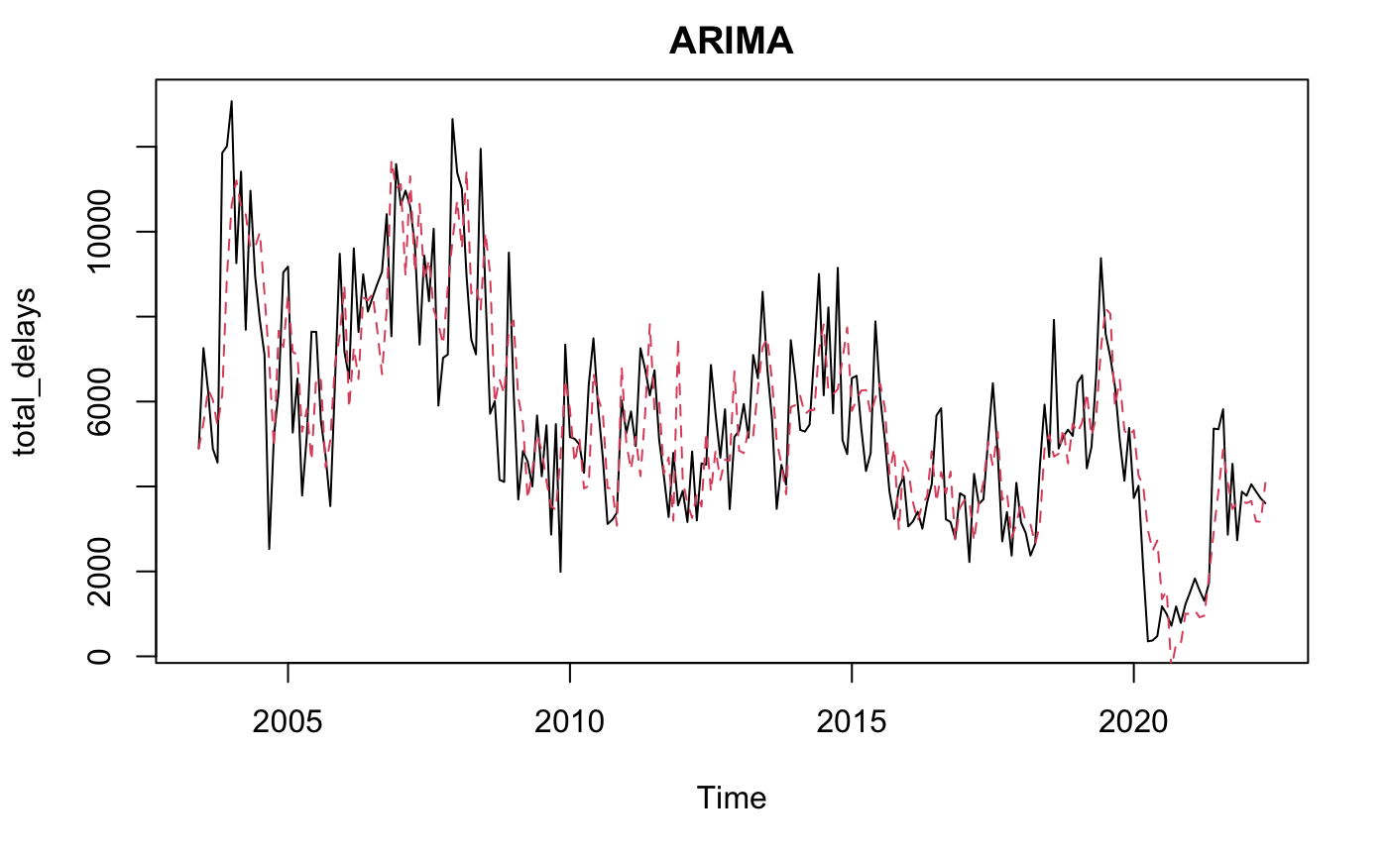
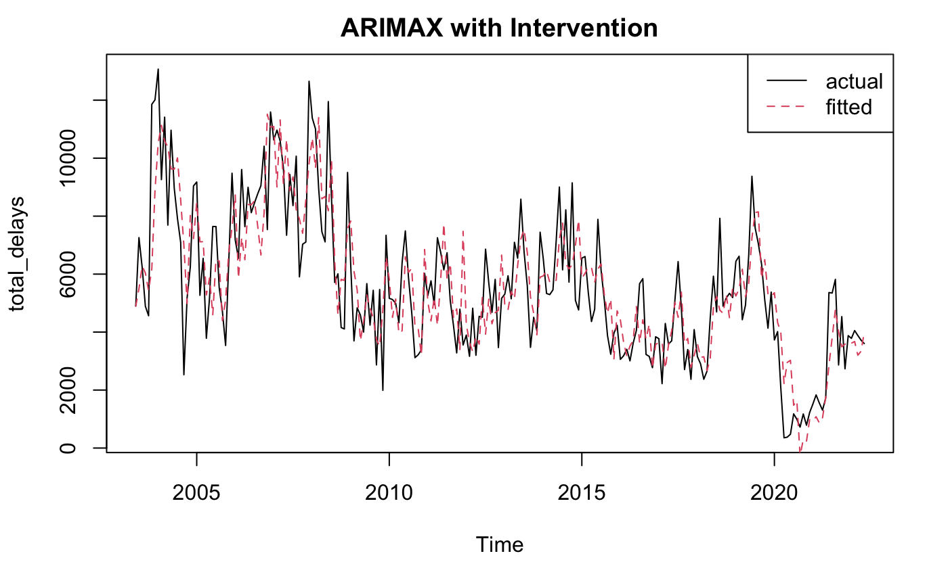
Intervention Analysis
Model | ME | RMSE | MAE | MPE | MAPE | ACF1
ARIMA | -5.017017 | 1477.300 | 1152.216 | -10.93993 | 30.27066 | -0.01722984
ARIMAX | 1.028579 | 1460.221 | 1143.482 | -10.84812 | 30.08481 | -0.01471830

Slide 17

Conclusion
Pre-Covid - Regression with Arima Errors on total flights provided the best results
Covid had a substantial impact on travel, causing total flights to drop and a reduction in model accuracy
Including Covid-era data resulted in two models with comparable results:
Regression with Arima Errors may be more accurate for future predictions and is easily explainable
By nature, Intervention analysis incorporates historical considerations and has more manual inputs
Next steps would be:
Model with weather data
Expand the dataset to include all major airports in US
It may be possible to combine the two Covid-era models to incorporate Regression W/ ARIMA Errors and Interventions.

Slide 18
Appendix

Slide 19
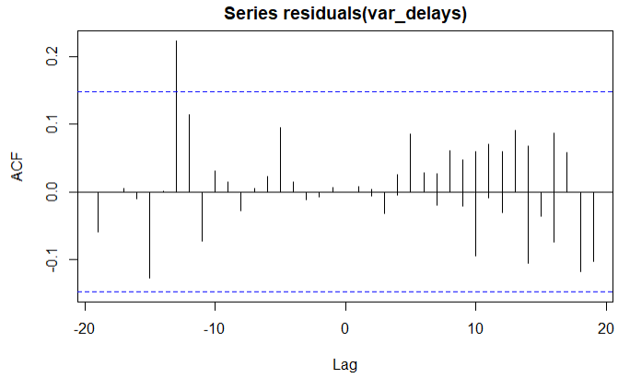
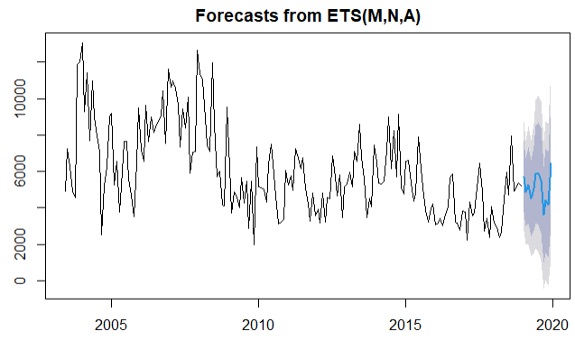
VAR Model
Using VAR would be a plausible option as well. The serial test for this model indicates that the residuals are not autocorrelated.

